Slide 1
SMART PARKING USING THRESHOLDING
Batch No : 79
Santhosh R (312321106152)
Sunil Selvendran M (312321106171)
Mentor : Dr.P.Ezhilarasi

Slide 2
PROBLEM STATEMENT
The persistent issue of drivers circling parking lots in search of available spaces presents a significant challenge to urban mobility and convenience.
Traditional parking systems often fail to efficiently utilize parking resources, leading to frustration and congestion for drivers. There is a need for a solution that streamlines the parking process, optimizes resource allocation, and enhances convenience for users.
This problem statement encapsulates the central issue addressed in your response and sets the stage for discussing the solution provided by automated car parking systems.

Slide 3
OBJECTIVES
Identify the widespread issue of parking congestion in urban settings. Highlight the negative impacts, including time wastage, increased fuel usage, and environmental harm.
Propose the adoption of smart parking systems as a remedy for these issues.
Outline the aim of the mini project: to devise and implement a smart parking system employing MATLAB's image processing capabilities.
Emphasize the goal of creating a system proficient in discerning occupied and vacant parking spaces.

Slide 4
LITERATURE SURVEY
Sl.No. | Title | Author | Year | Explanation
1 | Smart Parking Algorithm Based on Driver Behavior and Parking Traffic Predictions | Jiazao Lin and Shi-Yong Chen and Chih-Yung Chang and Guilin Chen | 2019 | SPA is a smart parking allocation algorithm prioritizing benefits and service quality. It predicts driver behavior and parking traffic from historical data to efficiently allocate resources. Using worst-fit, best-fit, and behavior forecast policies, SPA outperforms in parking rate and service quality. Its predictive analytics-based grid allocation enhances overall benefits for parking lots. SPA presents a promising solution for boosting smart parking systems' efficiency and effectiveness.

Slide 5
Sl.No. | Title | Author | Year | Explanation
2 | Deep Learning-Based Mobile Application Design for Smart Parking | H. CanliDepartment of Computer Engineering, Faculty of Engineering, Duzce University, Duzce, Turkey | 2021 | A new mobile smart parking app was created using deep learning and cloud tech to tackle urban parking challenges. It employs LSTM networks to predict space availability, accessible in real-time on mobile devices. Tested extensively with Istanbul's data, it outperformed Support Vector Machine, Random Forest, and ARIMA, confirming its accuracy. This innovation optimizes energy and time usage, reducing environmental impact and parking stress.

Slide 6
Sl.No. | Title | Author | Year | Explanation
3 | Smart Cooperative Parking Environment | Muhamed Alarbi and Anwar Haque and Abdelkareem Jaradat | 2023 | SCOPE is a cooperative system addressing urban parking shortages, utilizing a distributed architecture and interaction model. It optimizes traffic and communication among facilities through an overlay network and hierarchical nodes. By integrating a sharing economy model, it maximizes resource use and benefits private parking owners economically. Evaluation results demonstrate notable reductions in search time, traffic, cost, and pollution, improving driver satisfaction. SCOPE offers a holistic solution for smart parking, enhancing efficiency, sustainability, and economic viability in cities.

Slide 7
CHALLENGES IN EXISTING SYSTEM
Limited Parking Information: Existing systems often lack comprehensive real-time information about parking availability, leading to inefficiencies in parking utilization.
Inaccurate Data: The data provided by existing systems may be inaccurate or outdated, leading to incorrect information about parking availability and potentially causing frustration for users.
Limited Accessibility: Some systems may not be easily accessible to all users, particularly those without smartphones or internet access, limiting their effectiveness in providing parking information to a wide audience.
Dependency on Manual Monitoring: Systems that rely on manual monitoring for data collection and analysis may suffer from inconsistencies and delays in updating parking availability information, reducing their reliability for users.
Scalability Issues: Traditional systems may face scalability challenges when deployed in large parking facilities or across multiple locations, limiting their ability to accommodate growing demand and diverse parking scenarios.

Slide 8
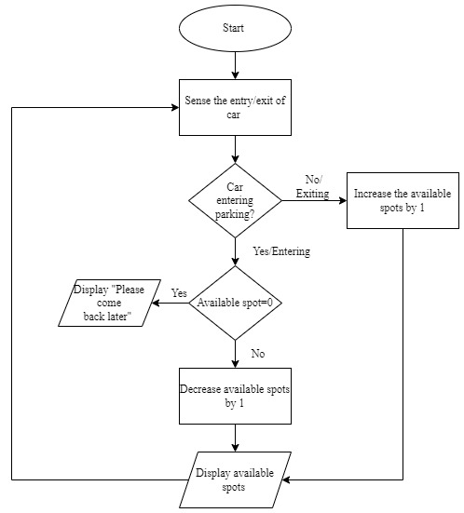
FLOW DIAGRAM

Slide 9
WORK PLAN
Image Preprocessing: Convert input and background images to grayscale and determine image size.
Foreground Detection: Calculate absolute difference between input and background images and threshold it to identify foreground objects.
Image Enhancement: Adjust intensity values, apply Gaussian noise, filter noise with a Weiner filter, convert to binary, fill holes, remove small objects, and label connected components.
Counting Cars: Use region properties to measure connected components and count cars.
Lane Division and Analysis: Divide parking area into lanes, detect cars and count vacancies for each lane, and display information for vacant lanes.
Output: Output lane numbers with available space, display total cars and vacancies, and visualize results using plots and images.
Exit Condition: If no vacancies are found, indicate the parking area is full and exit.
This condensed version maintains the essence of the original paragraphs while providing a concise overview of the solution steps.

Slide 10
PROPOSED SOLUTIONS
Develop a smart parking system using image processing techniques.
Capture parking area images using CCTV cameras.
Process images to detect parking spaces and classify occupancy.
Create a user-friendly GUI to display real-time parking availability.
Enable users to interact with the system and receive navigation instructions.
Integrate and deploy the system in urban parking areas.

Slide 11
MODULES
Image Input/Output Module:
imread: Reads an image from a file.
imshow: Displays an image.
imagesc: Displays a scaled version of the intensity image or binary image.
Image Processing Module:
rgb2gray: Converts an RGB image or colormap to grayscale.
imadjust: Adjusts the intensity values of an image or colormap.
imnoise: Adds noise to an image.
wiener2: Applies Wiener filtering to an image.
im2bw: Converts an image to binary image based on a threshold value.
imfill: Fills holes in objects in a binary image.
bwareaopen: Removes small objects from binary image.

Slide 12
Foreground Detection Module:
Absolute difference between images: Computes the absolute difference between the current frame and the background image.
Thresholding: Determines foreground pixels based on a predefined threshold.
Blob Detection Module:
bwlabel: Labels connected components in a binary image.
regionprops: Measures properties of image regions or objects.
Lane Division Module:
Divides the parking area into lanes for further analysis.
Vacant Space Detection Module:
Compares the number of detected cars with the total number of parking slots to determine vacant spaces.
Output Display Module:
Displays various images and information related to the parking area, foreground detection, blob detection, and vacant space detection.
Uses fprintf to print messages to the command window.

Slide 13
SCOPE AND APPLICATION OF THE PROJECT
SCOPE
The project aims to develop a system capable of detecting parking availability in real-time using CCTV camera images.
It involves image acquisition, preprocessing, parking space detection, occupancy classification, GUI development, and real-time updates.
The system will provide users with valuable parking information to streamline the parking process and reduce congestion.
The system will be cost-effective, efficient, and easy to install, making it suitable for deployment in various parking environments.
APPLICATIONS
The application of the project is primarily in urban parking areas where parking congestion is a significant issue.
It can be deployed in parking lots, garages, and on-street parking spaces.
Users, including drivers and parking lot operators, will benefit from real-time parking availability information provided by the system.
The system can be integrated with smartphone applications, allowing users to access parking information on the go.

Slide 14
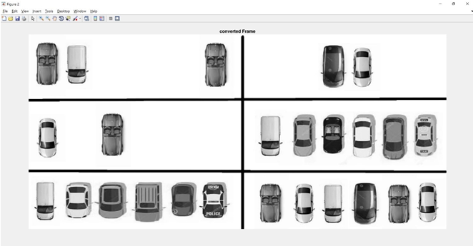
IMAGE ENHANCEMENT

Slide 15
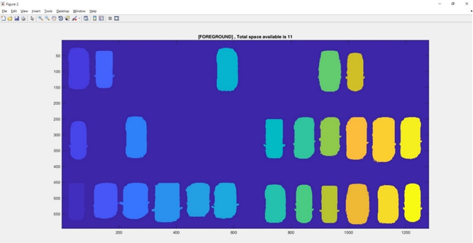
IMAGE DETECTION

Slide 16
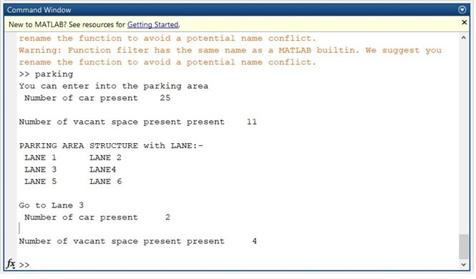
OUTPUT

Slide 17
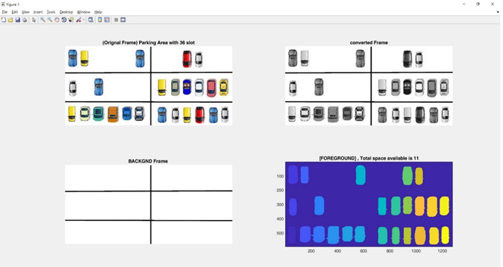
Total Space Figure

Slide 18
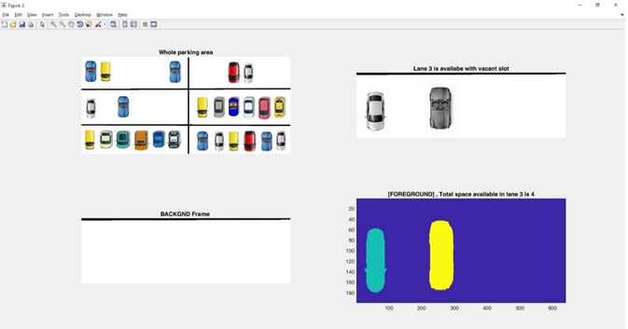
Available Figure

Slide 19
Sustainable Development Goals
Responsible Consumption and Production:
Optimizing parking space utilization can contribute to more efficient use of resources and reduce waste associated with urban transportation.

Slide 20
CONCLUSION
1. Image Processing Focus: The project emphasizes learning about image processing, a vital technology in various fields. By developing a parking space detection system using MATLAB, the project explores the practical application of image processing, enhancing understanding in this relevant field.
2. Cost-Effective and Scalable: Utilizing CCTV cameras, the system can efficiently manage large parking areas without the need for complex equipment. Its simplicity makes it affordable and easy to install, offering a cost-effective solution for parking space management.
3. Real-Time Guidance: The system provides real-time parking information to drivers through a guidance information display, enhancing user experience and facilitating efficient parking. This feature improves traffic flow and reduces congestion, offering practical benefits to both drivers and parking lot operators.

Slide 21
REFERENCE
1.Abhirup Khanna, Rishi Anand, “IoT based Smart Parking System”, Proc., In 2016 International Conference on Internet of Things and Applications (IOTA), 22 Jan - 24 Jan 2016.
2.Anusha, Arshitha M, S, Anushri, Geetanjali Bishtannavar “Review Paper on Smart Parking System,” International Journal of Engineering Research & Technology (IJERT), ISSN: 2278-0181, Volume 7,
Issue 08, Special Issue – 2019. Tuticorin District Using Landsat Images”, IJIEST ISSN (2455-8494), Vol.03, No. 01, Jan 2018.
3.Juhi Seth, Pola Ashritha, R Namith, “Smart Parking System using IoT ElakyaR”, International
Journal of Engineering and Advanced Technology (IJEAT), ISSN: 2249 – 8958, Volume-9 Issue-1, October 2019.
4.Mimbela, L.Y. and L.A. Klein, “A summary of vehicle detection and surveillance technologies used in intelligent transportation systems”, New Mexico State University, Tech. The report, 2007.
5.M. Y. I. Idris, Y. Y. Leon, E. M. Tamil, N. M. Noor, and Z. Razak, “Car parking system: A review of the smart parking system and its technology,” Information Technology Journal, pp. 101-113.], 2009.

Slide 22
6.Mechkul Jayakshei Dadaji Bachhava, "Smart Car Parking System", International Research Journal of Engineering and Technology (IRJET, vol. 04, no. 06, June 2017.
7.Sagar Rane, Aman Dubey and Tejisman Parida, "Design of IoT Based Intelligent Parking System Using Image Processing Algorithms", 2017 International Conference on Computing Methodologies and Communication.
8.Abhirup Khanna and Rishi Anand, "IoT based smart parking system", 2016 international conference of IoT and applications.
9.Chungsan Lee, Youngtak Han, Soobin Jeon, Dongmahn Seo and Inbum Jung, "Smart Parking System for Internet of Things", 2016 IEEE International Conference on. Consumer Electronics.
10.SR Basavaraju, "Automatic Smart Parking System using Internet of Things (IoT)", International Journal of Scientific and Research Publications, vol. 5, no. 12, December 2015

